Slide 1
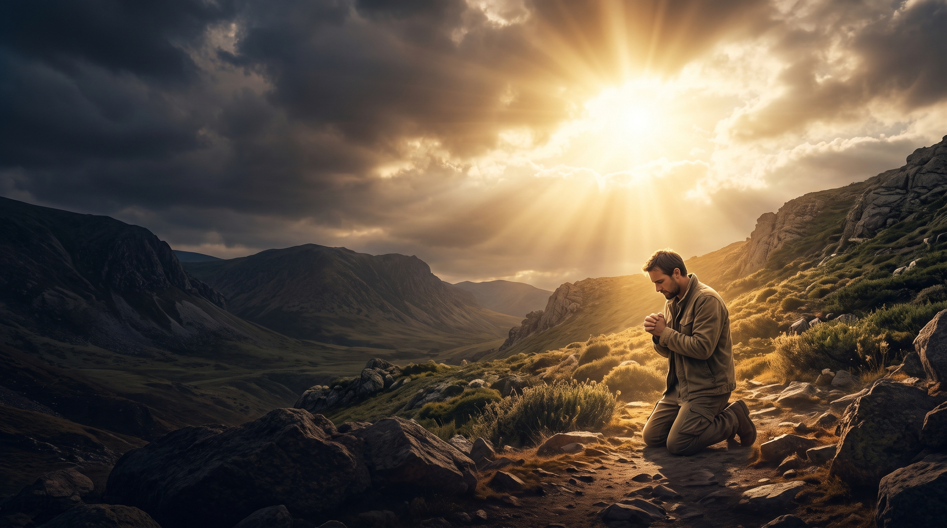

THE MAN
WHO
SAYS “YES”
TO GOD
“Here am I; send me.”
ISAIAH 6:8, NIV

Slide 2
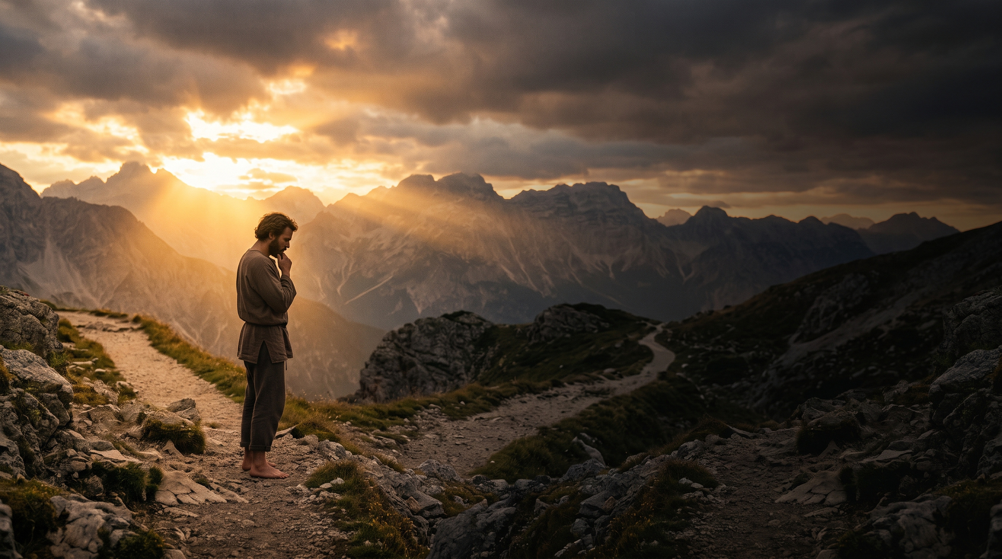
Three Questions
for Every Human
IF GOD CALLED YOU TODAY, WOULD YOU SAY YES?
WHAT IF GOD’S ASSIGNMENT IS DIFFICULT?
ARE YOU WAITING TO BECOME “READY” BEFORE OBEYING GOD?
2
Notes:
God does not primarily look for the most talented man — He looks for a man willing to surrender and obey Him.

Slide 3
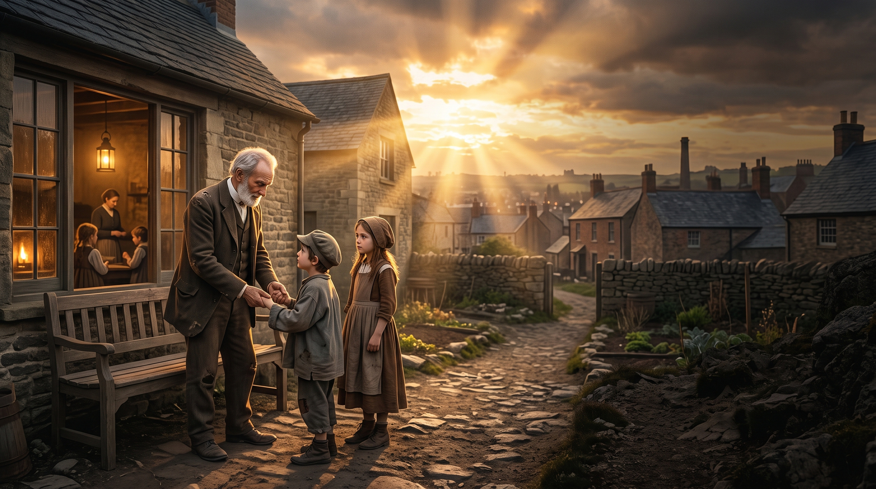
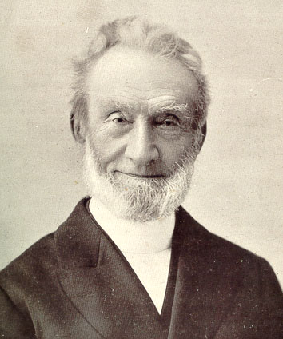
George Müller: “Yes” to God
Müller chose to trust God rather than build his ministry around personal wealth or human security. He prayed, worked, served, and trusted God to provide what was needed. His life became a testimony that God can use an ordinary man who is surrendered to Him.
19TH-CENTURY
ENGLAND
Devoted his life to
caring for orphaned
children
3
Notes:
The question is not: “How capable am I?”
The question is: “Am I willing to say YES to God?”
The StoryThe Empty Table:
George Müller ran an orphanage in Bristol, England. One morning, the children stood by the dining table, but the larder was completely empty and there was no money to buy food.
The Prayer of Thanks: Instead of panicking or asking anyone for money, Müller had the children sit down and led them in prayer, thanking God for the food they were about to receive.
The Baker's Knock: Right after the prayer, a knock came at the door. The local baker stood there and explained that he could not sleep the night before because he felt God wanted him to bake bread for the orphans, so he started at 2:00 a.m.
The Milkman's Knock: Almost immediately after, a second knock sounded. It was a milkman whose cart had broken down right outside the orphanage. He asked if the children could use his fresh milk so he could empty the wagon and fix it.

Slide 4

KEY BIBLE VERSE
“Whom shall I send?”
God asks the question — and waits for a willing heart to answer.
Isaiah’s answer,
“Here am I; send me.”
Isaiah 6:8
4
Notes:
Before God uses a man, God must become greater in that man’s heart.
The Call and Mission of Isaiah
A Willing Heart: In Isaiah 6:8, God asked, "Whom shall I send, and who will go for us?" Isaiah answered immediately, "Here am I. Send me!"
Spiritual Purification: Before his mission began, God cleansed Isaiah's lips with a burning coal in a temple vision, showing that God prepares and qualifies those He chooses.
Calling Out Injustice: God used Isaiah to expose empty religious rituals, corruption among leaders, and mistreatment of the poor and vulnerable.

Slide 5

5

Slide 6
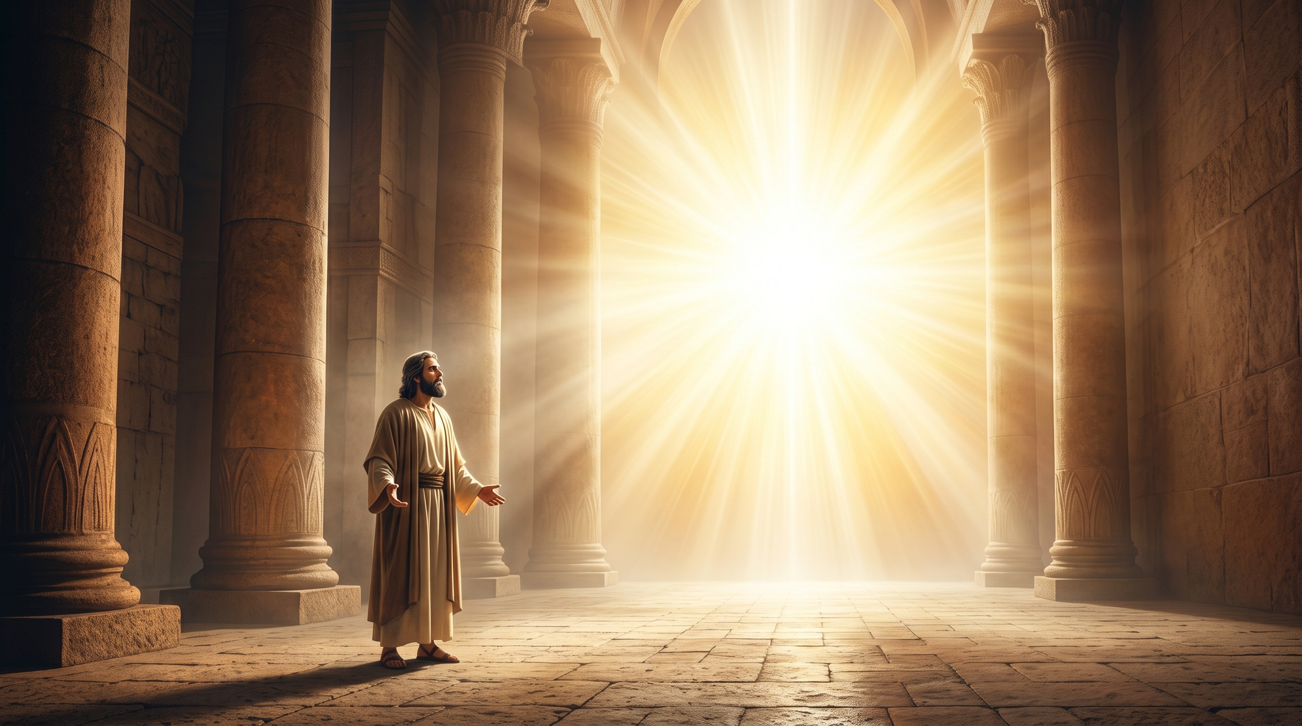
THE BIBLE STORY — ISAIAH 6:1–3
Isaiah Saw the Lord
SEATED ON A THRONE
SURROUNDED IN GLORY
“HOLY, HOLY, HOLY”
Isaiah encountered the Lord high and exalted, ruling over all.
Heavenly beings attended Him, declaring His holiness aloud.
The seraphim proclaimed the absolute holiness of the Lord.
ISAIAH 6:1
ISAIAH 6:2
ISAIAH 6:3
6
Notes:
Key Purposes of His Prophetic Work
Warning of Judgment: Isaiah warned Judah that turning away from God and trusting in foreign alliances instead of the Lord would lead to destruction by empires like Assyria and Babylon.
Promising Hope and a Savior: Isaiah spoke profound prophecies about the coming Messiah (Jesus Christ), detailing His birth from a virgin, His suffering for human sin, and His peaceful eternal reign.
A Light to the Nations: His messages reminded the people that God remains sovereign, faithful to His covenant, and capable of bringing a new creation even out of total ruin.

Slide 7
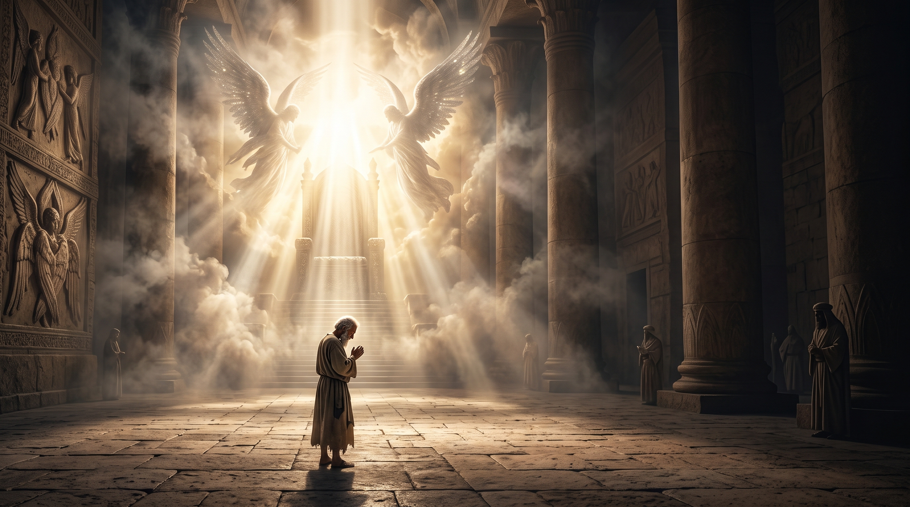
LESSON 1
HOLY
God Uses the Man Who Recognizes Who God Is
GLORIOUS
Isaiah’s willingness began when he saw the Lord. He did not begin by asking “What can I do?” He first asked, “Who is God?”
SOVEREIGN
“BE STILL, AND KNOW THAT I AM GOD.” — PSALM 46:10
WORTHY
7
Notes:
When we see God correctly, we see ourselves correctly. And when God becomes greater in our eyes, surrender becomes easier.
A right view of God produces a surrendered heart.

Slide 8

LESSON 2
God Uses the Man Who
Allows God to Change Him
1
2
3
4
ISAIAH
RECOGNIZED HIS
CONDITION
GOD REVEALED
HIMSELF
GOD CLEANSED
ISAIAH
GOD
CALLED
ISAIAH
“YOUR GUILT IS TAKEN AWAY,
YOUR SIN ATONED FOR.” — ISAIAH 6:7
8
Notes:
Isaiah recognized his condition before the holiness of God — and God did not leave him there. God provided cleansing, and then gave him a calling.
God begins to change the man before He sends him — and keeps changing him as He uses him

Slide 9
LESSON 3
God Uses the Man
Who Is Willing to Go
Isaiah’s willingness began when he saw the Lord. He did not begin by asking “What can I do?” He first asked, “Who is God?”
FAITH DOESN’T REQUIRE KNOWING EVERYTHING.
FAITH REQUIRES TRUSTING GOD.
9
Notes:
Isaiah recognized his condition before the holiness of God — and God did not leave him there. God provided cleansing, and then gave him a calling.
God begins to change the man before He sends him — and keeps changing him as He uses him

Slide 10
APPLICATION 1
Say YES
in Your Home
  Praying with your family
  Leading with humility
  Choosing faithfulness over convenience
  Asking God for wisdom before making decisions
  Being an example of Christ in your home
God doesn’t only want men who serve publicly — He wants men who honor Him privately.
“AS FOR ME AND MY HOUSEHOLD, WE WILL SERVE THE LORD.” — JOSHUA 24:15
10
Notes:
Our first ministry is our family, at home.

Slide 11
Sometimes God’s calling will interrupt:
APPLICATION 2
Say YES
When It Is Inconvenient
YOUR PLANS
YOUR COMFORT
Obedience is easy when everything is convenient. But sometimes God asks us to obey when it costs us something. Obedience is not measured by convenience.
YOUR SCHEDULE
YOUR EXPECTATIONS
“NOT MY WILL, BUT YOURS BE DONE.” — LUKE 22:42
11
Notes:
Our first ministry is our family, at home.

Slide 12
APPLICATION 3
Say YES Even When You Feel Unqualified
“I’M NOT SPIRITUAL ENOUGH.”
“I DON’T KNOW ENOUGH.”
Isaiah wasn’t a perfect man. He encountered God, recognized his need, received God’s cleansing, and surrendered to God’s calling.
“SOMEONE ELSE CAN DO IT BETTER.”
“MY POWER IS MADE PERFECT IN WEAKNESS.” — 2 CORINTHIANS 12:9
12
Notes:
Your weakness does not limit God — but don’t let insecurity become an excuse for disobedience.
The issue isn’t whether you are enough.
The issue is whether you will trust the God who is enough.

Slide 13
THE BIGGER PICTURE
What Does God Look For?
THE STRONGEST MAN
THE SMARTEST MAN
THE MOST
TALENTED MAN
THE MOST
SUCCESSFUL MAN
“THE LORD LOOKS AT THE HEART.” — 1 SAMUEL 16:7
13

Slide 14
THE BIGGER PICTURE
What Does God Look For?
THE STRONGEST MAN
“LORD, YOU ARE GREATER THAN ME.”
THE SMARTEST MAN
“LORD, CHANGE ME.”
THE MOST
TALENTED MAN
“LORD, SEND ME.”
THE MOST
SUCCESSFUL MAN
“LORD, I WILL OBEY YOU.”
“THE LORD LOOKS AT THE HEART.” — 1 SAMUEL 16:7
14

Slide 15
THE CHALLENGE
God Is Still Calling
The question God asked Isaiah — “Whom shall I send?” — is not only for pastors, missionaries, or church leaders. God calls ordinary people to live for Him.
LEAD
SERVE
LOVE
OBEY
STAND FOR
WHAT IS RIGHT
THE QUESTION BECOMES PERSONAL: WILL YOU SAY YES?
POINT OTHERS TOWARD CHRIST
15

Slide 16
CONCLUSION
The Man God Uses
Not necessarily the strongest, the smartest, the most talented, or the most successful man —
1
ISAIAH SAW GOD
2
RECOGNIZED HIS NEED
3
GOD CLEANSED HIM
4
GOD CALLED HIM
HE IS THE MAN
WHO SURRENDERS TO GOD.
5
“HERE AM I; SEND ME”
16
Notes:
Father, thank You because You are holy, sovereign, and worthy. We recognize that we are not perfect and that we cannot accomplish Your purposes through our own strength. Change our hearts. Teach us to see You correctly. Teach us to trust You completely.
When You call us, give us the courage to respond. When obedience is difficult, help us remain faithful. When we feel unqualified, remind us that our confidence is not in ourselves but in You.
Make us men who honor You in our homes, our schools, our workplaces, our relationships, and wherever You send us. May our lives not point people toward ourselves, but toward Jesus Christ.

